Slide 1
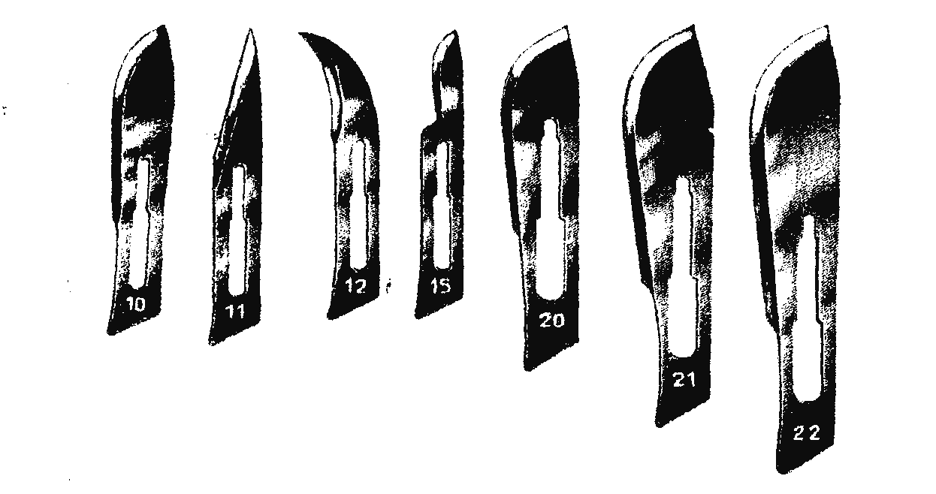
Common surgical instruments
THE SCALPEL BLADES

Slide 2
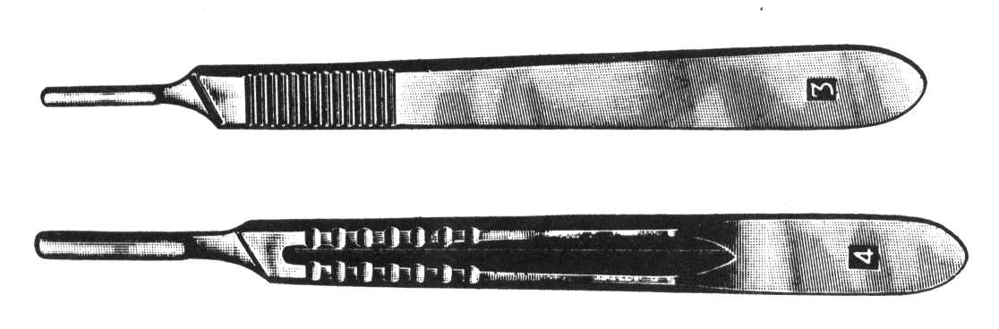
Scalpel handles

Slide 3
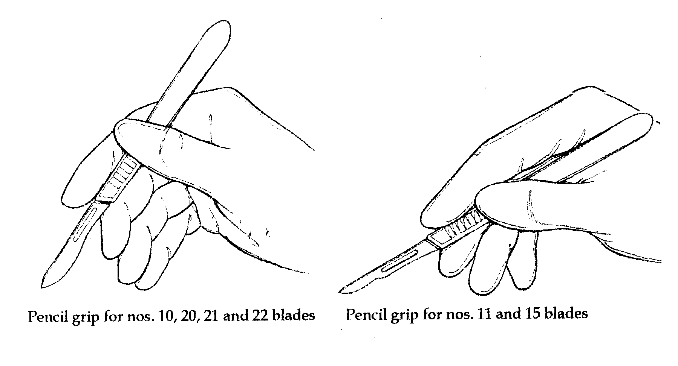
HOLDING THE SCALPEL
Pencil grip

Slide 4
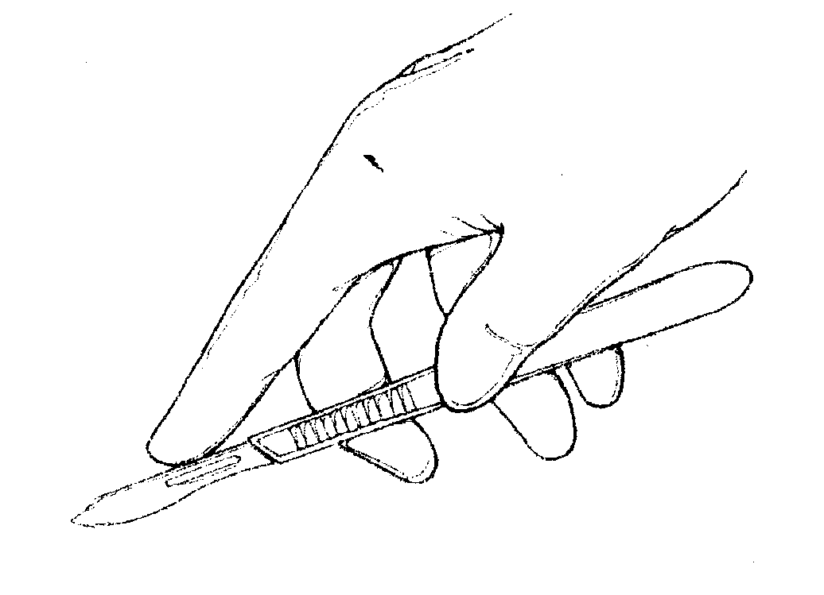
Fingertip grip

Slide 5
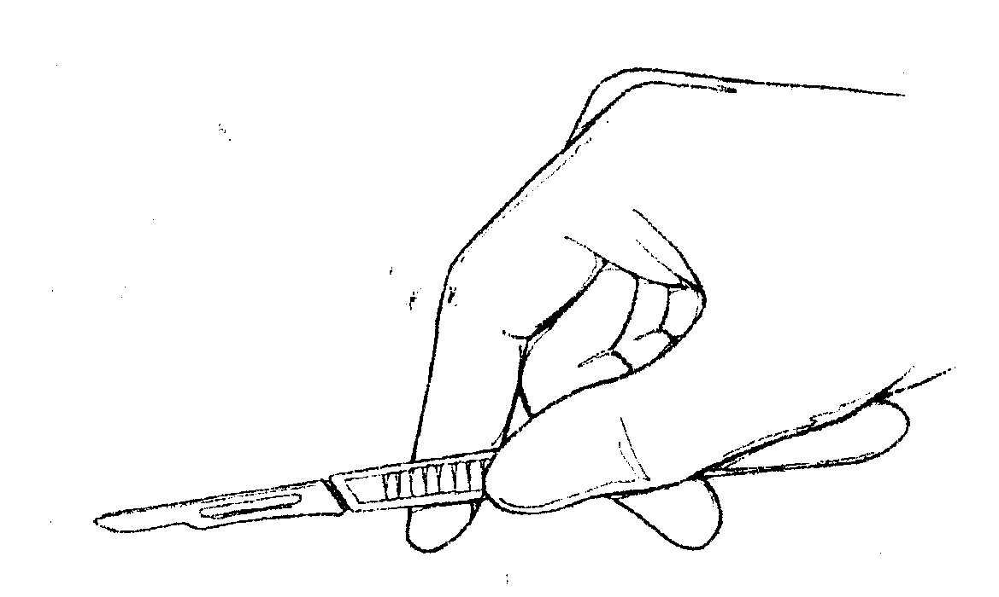
Palm grip

Slide 6
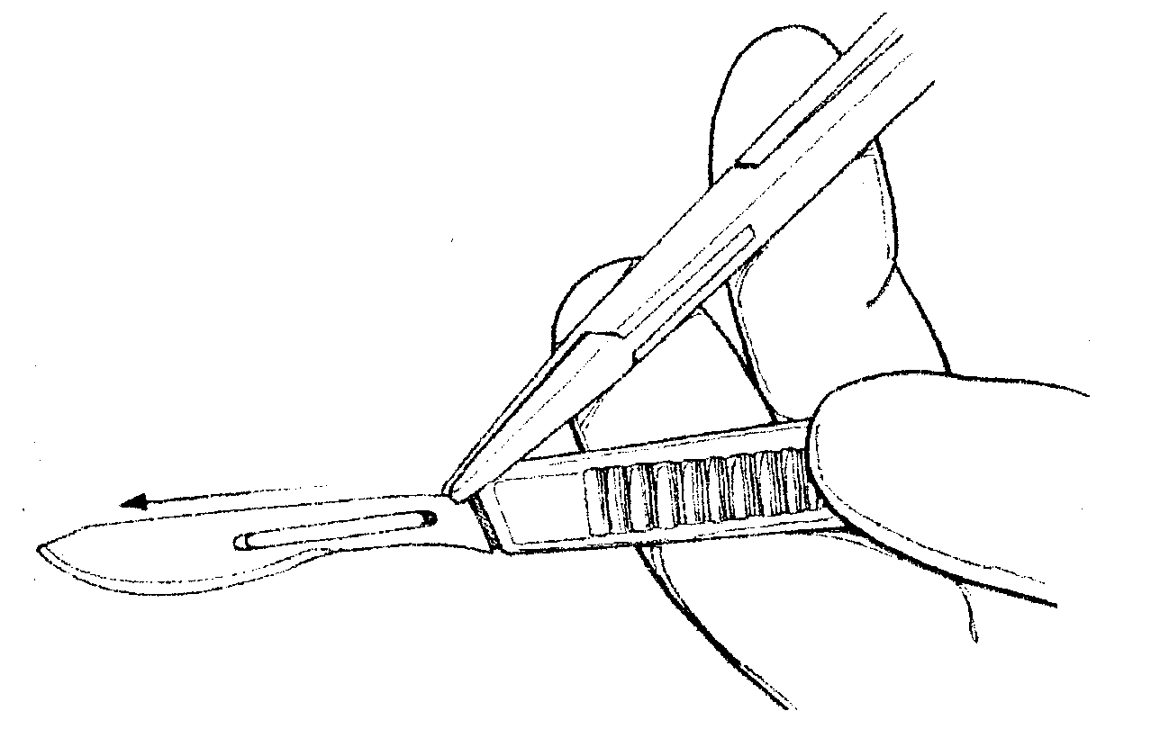
Removing a used scalpel blade

Slide 7
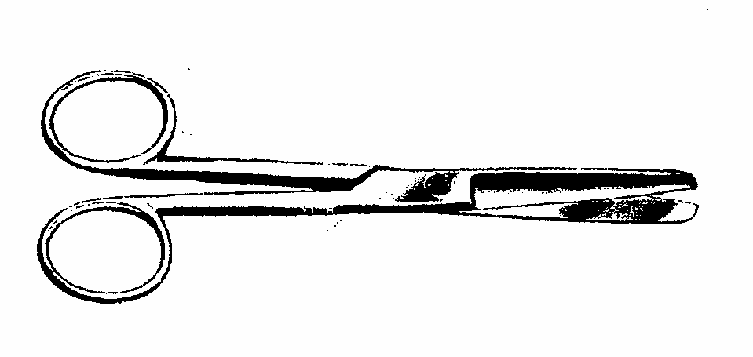
SCISSORS
Blunt/blunt tips

Slide 8
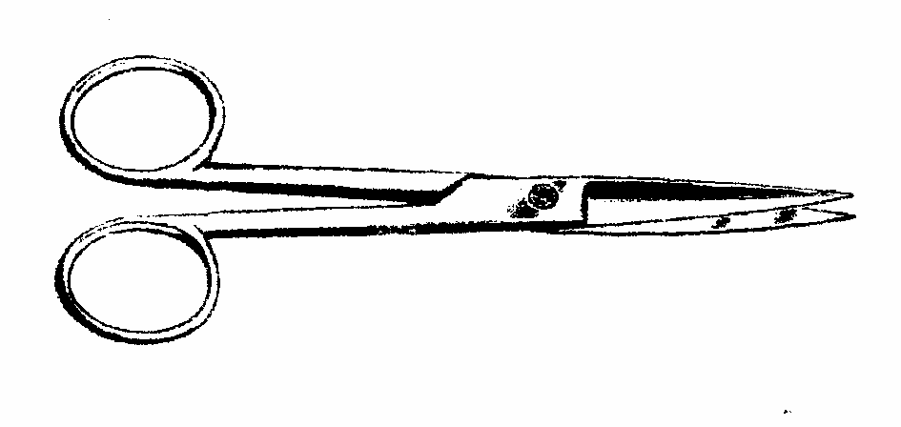
sharp/ sharp tips

Slide 9
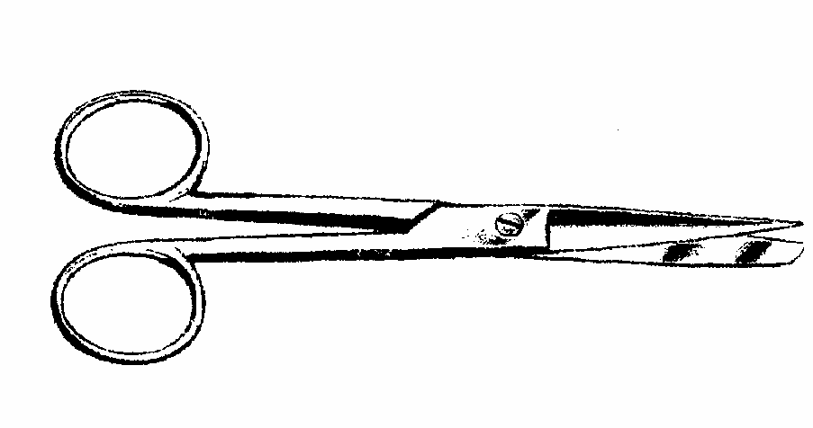
Sharp/blunt tips

Slide 10
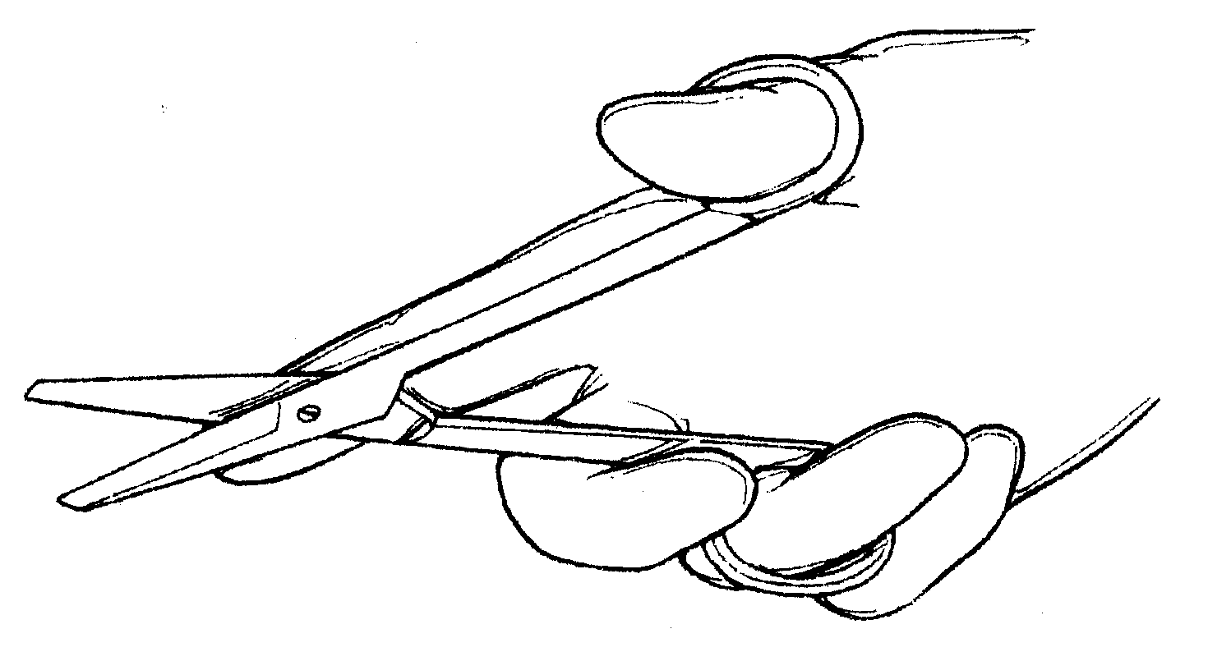
Correct way of holding a pair of scissors

Slide 11
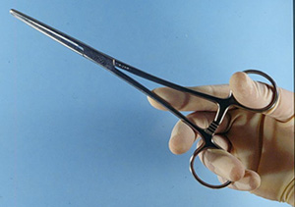
Handling scissors and haemostats

Slide 12
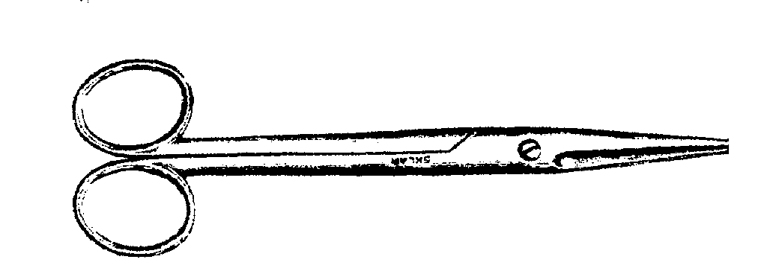
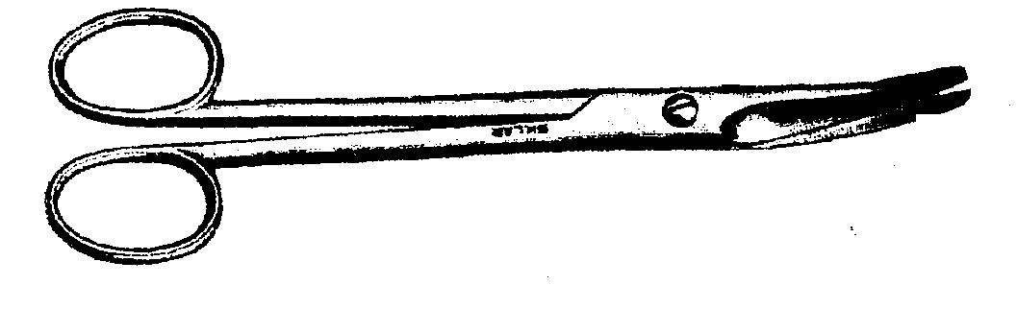
SCISSORS
Mayo straight scissors Mayo curved scissors

Slide 13
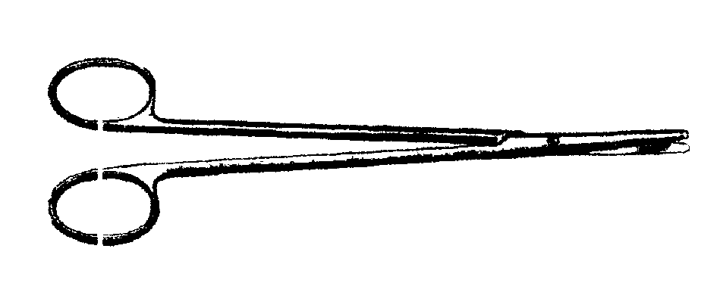
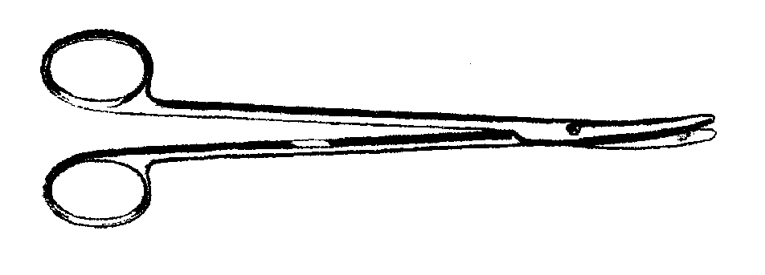
Metzenbaum straight and curved scissors (metz)
.

Slide 14
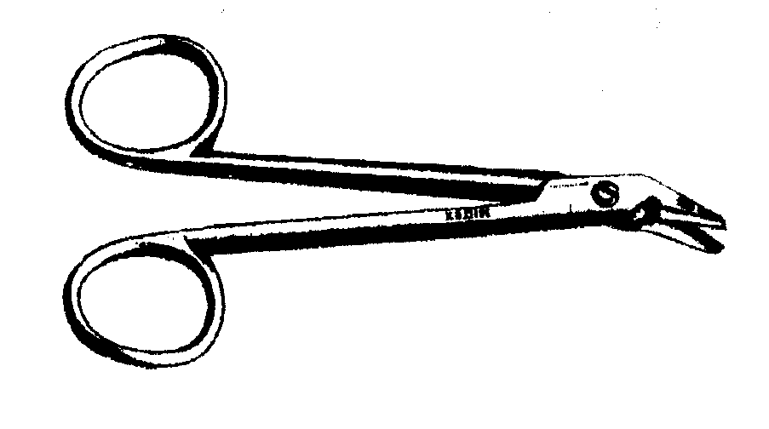
Wire cutting scissors

Slide 15
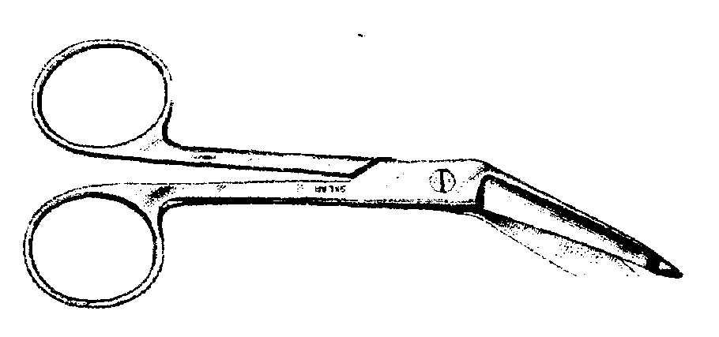
Bandage scissors

Slide 16
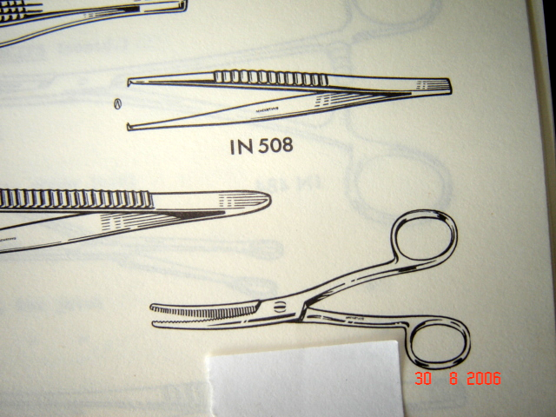
HAEMOSTATIC FORCEPS
Halstead mosquito forceps

Slide 17
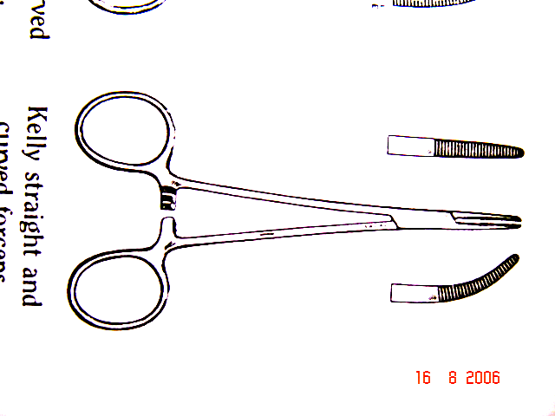
: Kelly forceps (straight and curved)

Slide 18
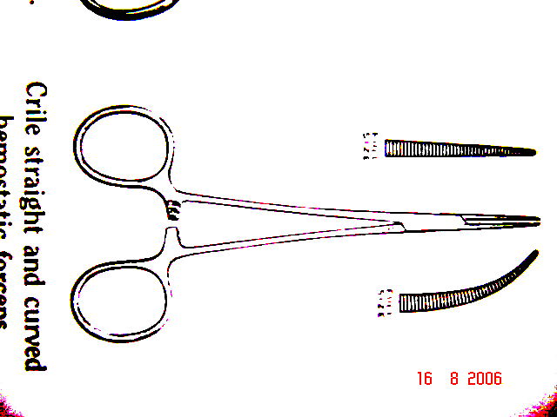
Crile forceps (Straight and curved)

Slide 19
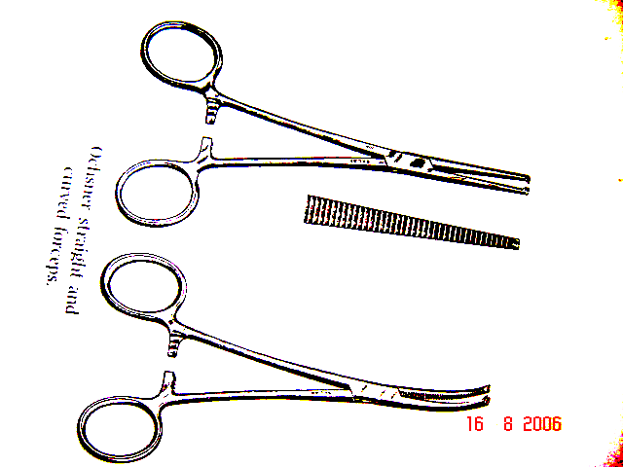
Mayo-Ochsner forceps (straight and curved)

Slide 20
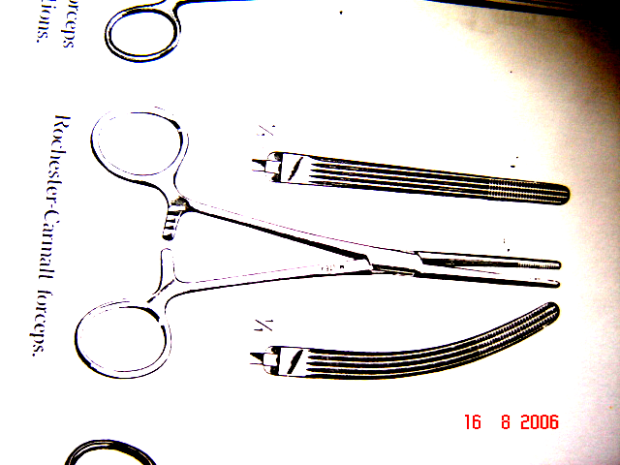
Carmalt forceps (straight and curved)

Slide 21
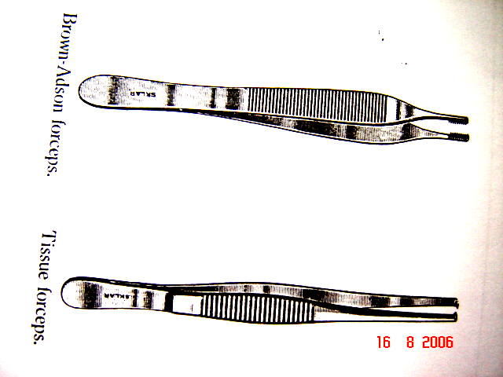
Types of Thumb forceps

Slide 22
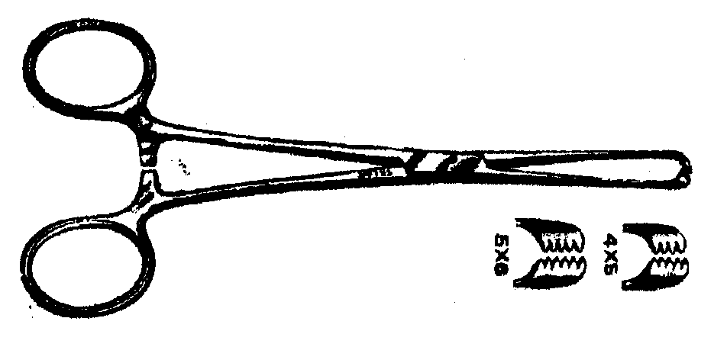
Tissue holding forceps
Allis tissue forceps

Slide 23
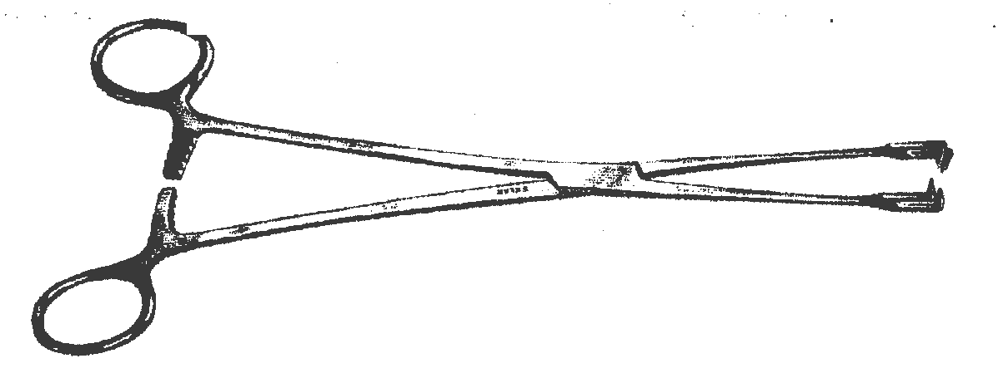
Vulsellum forceps

Slide 24
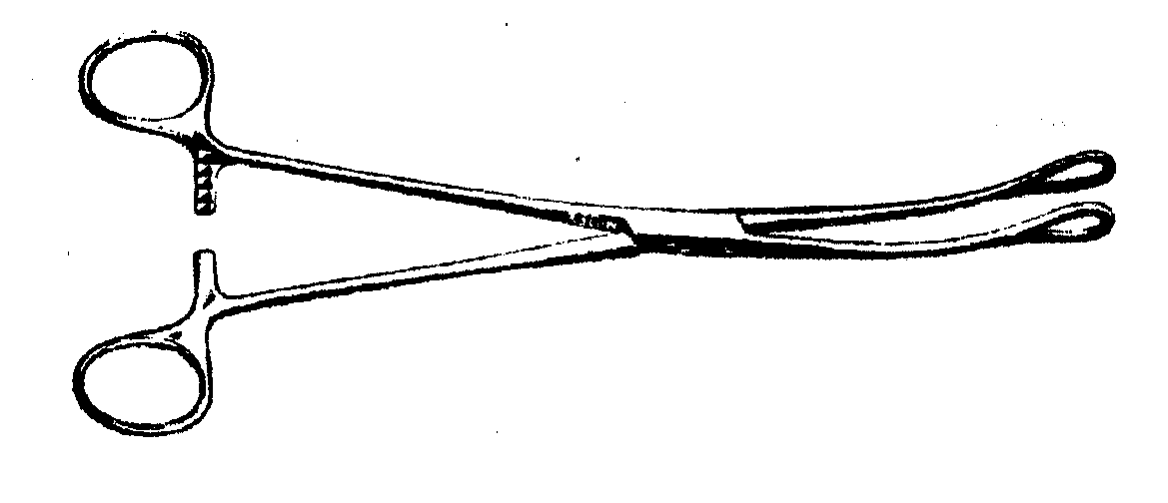
curved sponge forceps

Slide 25
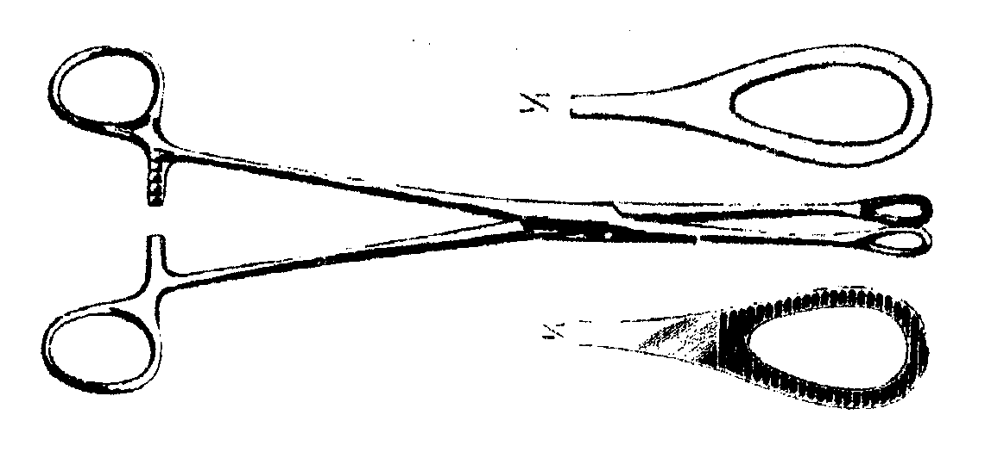
straight sponge forceps

Slide 26
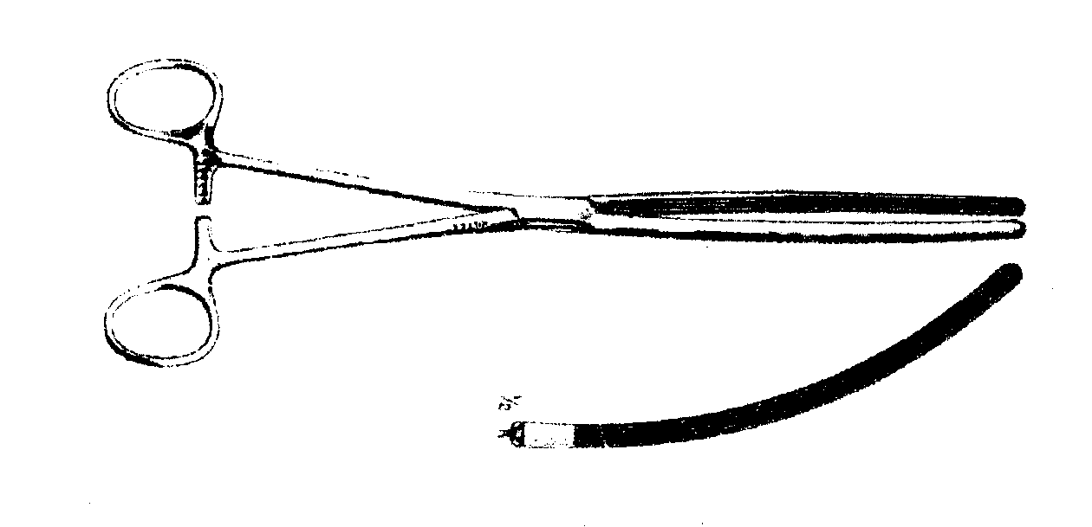
Doyen’s forceps

Slide 27
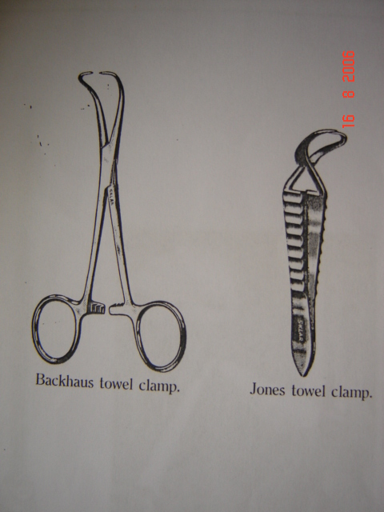
Towel forceps

Slide 28
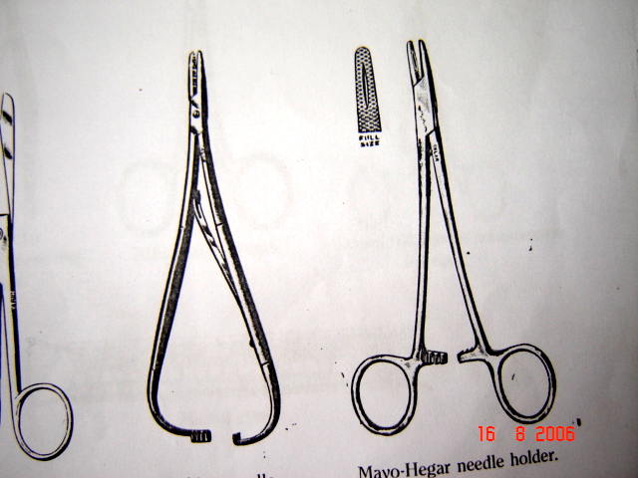
NEEDLE HOLDERS
Mayo-Hegar and Mathieu

Slide 29
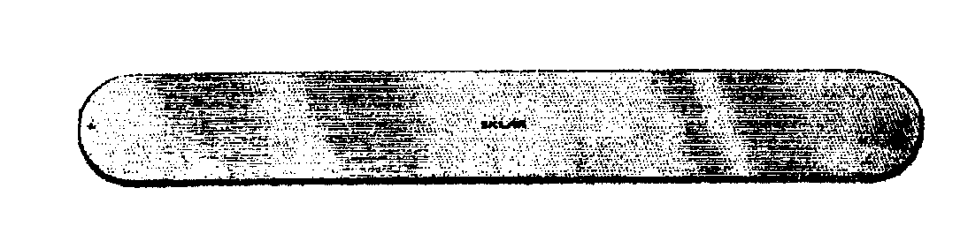
TISSUE RETRACTORS
Malleable retractor

Slide 30
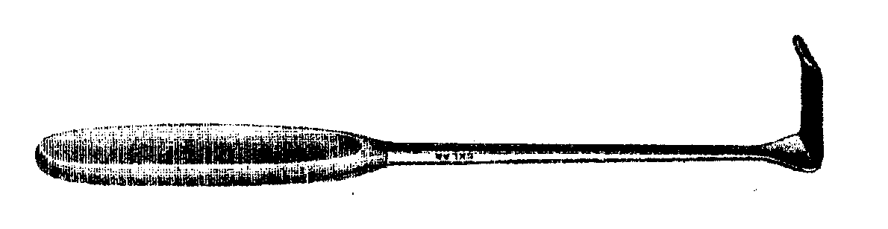
Langenbeck retractor

Slide 31
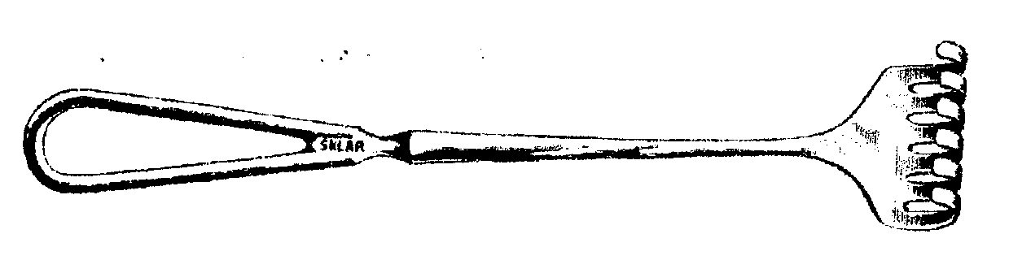
Volkmann retractor

Slide 32
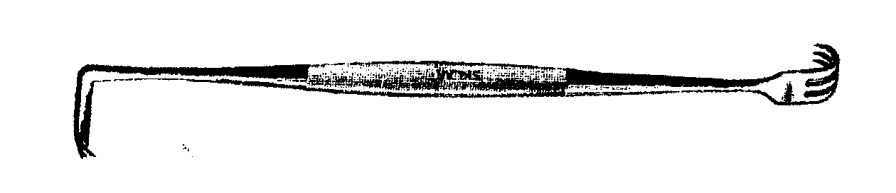
Senn retractor

Slide 33
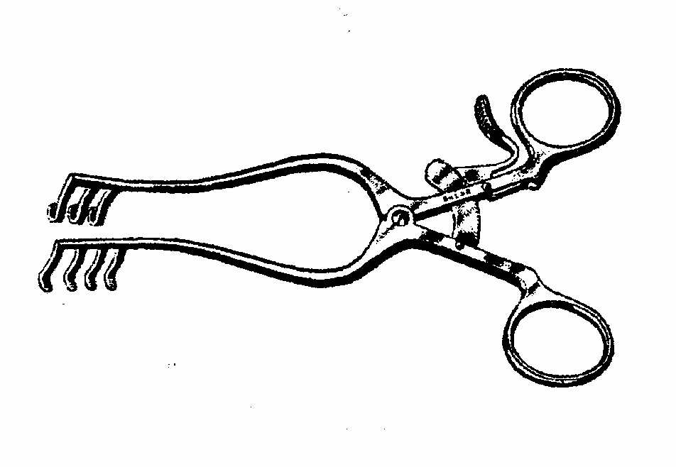
Weitlaner self retaining retractor

Slide 34
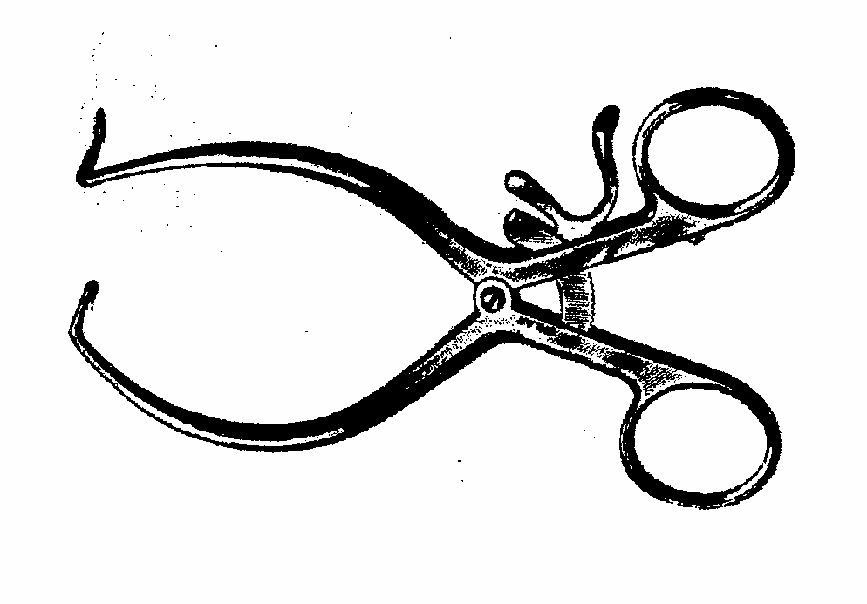
Gelpi self-retaining retractor

Slide 35
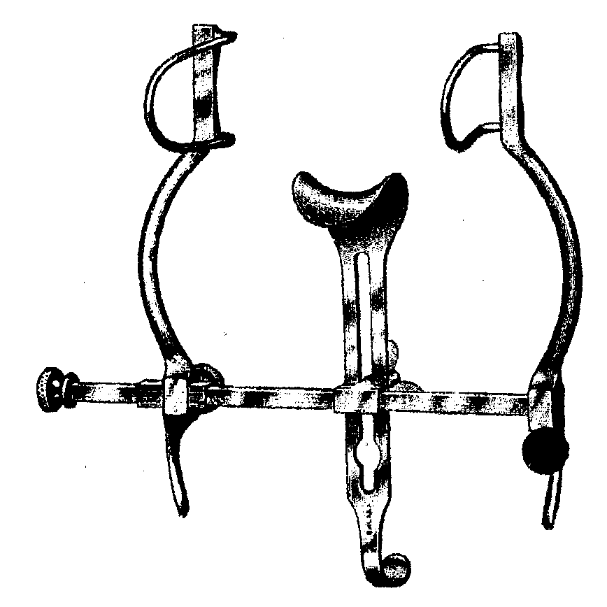
Balfour retractor

Slide 36
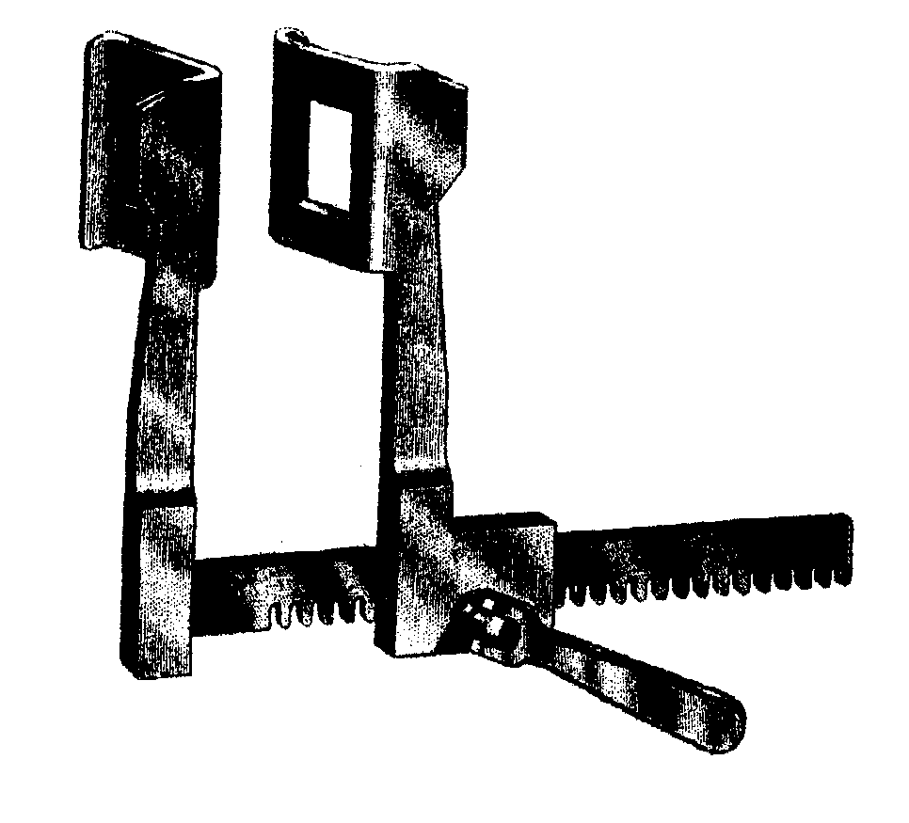
Finochietto rib

Slide 37
Other items in a surgical package
Saline bowl
Surgical swabs or sponges
Instrument pan or tray

Slide 38
Specialized surgical instruments
Orthopaedic instruments
Dental instruments

Slide 39
